Slide 1
Predicting the best place to open a luxury hotel in Brussels, Belgium
Shalakha Khandelwal
November 30,2019

Slide 2
Introduction
This presentation is for those who are planning to start a new hotel in the city of Brussels. I will provide a suggestion on what would be the best venue to start a new hotel in this densely populated and highly visited city.
Brussels is a region of Belgium comprising 19 municipalities, including the City of Brussels, which is the capital of Belgium. Brussels is located in the central portion of the country and is a part of both the French Community of Belgium and the Flemish Community.
Brussels is the most densely populated and the richest region in Belgium in terms of GDP per capita.
Some touristic attractions like Medieval Grand-Place, is indeed grand, with many 17th-century buildings and daily flower markets.
Reopened in 2006, the Atomium, Brussels' Eiffel Tower, provides great views, inside and out. Architecture fans should visit Musee Horta, home of Belgian master architect Victor Horta. St. Gery's clubs and bars are packed year-round. Seafood eateries abound in Ste. Catherine. Walk, rather than get snarled up in traffic, in the narrow streets.

Slide 3
Business Problem
We will focus on the issue of where to open a new hotel in a city like Brussels, once one has decided to go ahead. Let’s imagine Marriott Hotels are willing to open a new luxury hotel, the first and foremost important decision will be the location for its new hotel.
On what basis can they decide the new hotel's location?
While selecting the place there are key points to consider like they need to check where the most well-visited venues of the city are?
If in case there are already other luxury hotels which have good ratings, will it be risky to open new one near these hotels?
Out of scope for this project: Rent and land values in the neighbourhoods, budget for the interior decoration of the hotel, budget for opening different restaurants in the hotel etc.

Slide 4
Data acquisition and cleaning
As we are doing analysis for those who want to open a new luxury hotel in Brussels,
The first requirement is to collect Brussels postal codes data with the name of respective neighbourhoods.
The second requirement would be collect data related to latitude and longitude values of the same neighbourhoods.
The third requirement would be clean data as required for the analysis and
The fourth requirement would be to merge two datasets to be used for exploratory analysis.

Slide 5
Data acquisition
We will extract the data of all municipalities(municipality names and their postal codes) from below Wikipedia page using Beautiful Soup.
List of municipalities Brussels-Capital Region
We will extract the data related to latitude and longitude values of Neighbourhoods with a csv file (zipcode-belgium.csv) saved at local machine and then at the server.
Now let's use Foursquare Location to get the amount of most visited venues per Neighbourhood. The details can be retrieved using search endpoint. Link to the dataset is:
Foursquare Developer site

Slide 6
Data cleaning
Data cleaning for neighbourhood data with their postal codes
Required data is in table with class – ‘wikitable sortable’, so we extract data and transform it into a new pandas data frame.
Data cleaning here will include removing extra columns, changing data type of postal codes from string to integer etc.
Data frame after data cleaning –

Slide 7
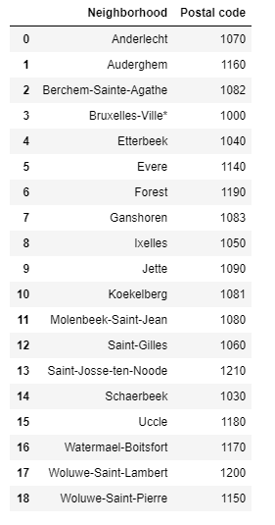
Continued…

Slide 8
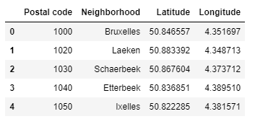
Data cleaning
Data cleaning for Neighbourhood data with their latitude and longitude values
Data was extracted from a csv file named – zipcode-belgium.csv located at local system. This file was then saved to Watson studio server and data was extracted in notebook using pd.read_csv function to pandas data frame.
Top 5 rows of data in df_data_0 data frame –

Slide 9
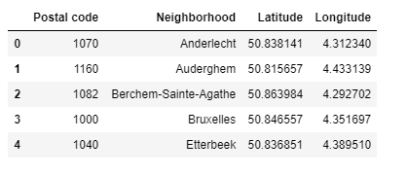
Data cleaning
Merging two data frames into a single data frame for further analysis
The two data frames were merged using pd.merge function and below is the screenshot of top 5 rows of resulting data frame(Brussel_df) –

Slide 10
Exploratory Analysis
In this phase, I worked on detailed analysis of source data to identify best locations to open a luxury hotel in Brussels.
This analysis includes below steps –
Importing libraries and creating map of Brussels with Neighbourhoods
Creating a data frame with top 10 venues of each Neighbourhood
Cluster Neighbourhoods - Run k-means to cluster the neighbourhoods into 7 clusters
Visualizing resulting clusters

Slide 11
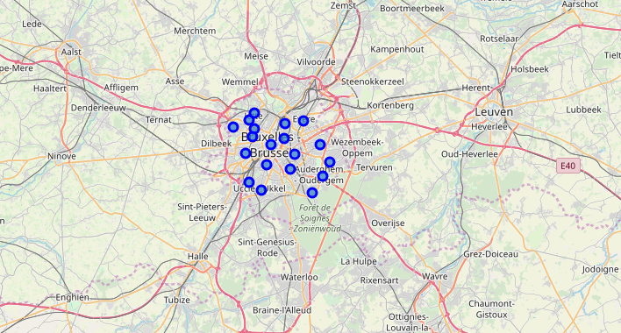
Importing libraries and creating map of Brussels with Neighbourhoods
Libraries imported: Matplotlib and associated plotting modules, Geocoder nominatin to convert an address to latitude and longitude values, K-means for clustering stage and Folium(map rendering library).
Used geocoder to get latitude and longitude values of Brussels and create a map including all the Neighbourhoods of Brussels.

Slide 12
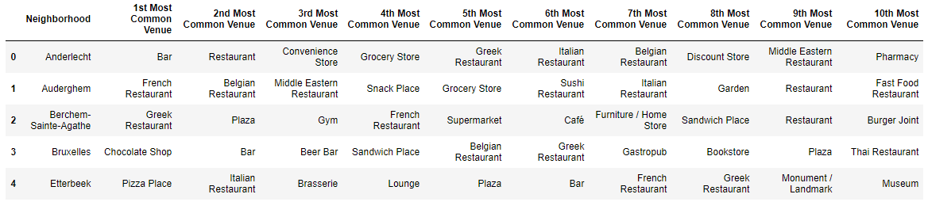
Creating a data frame with top 10 venues of each neighbourhood
Created a function to get nearby venues of each neighbourhood.
Grouped the data based on ‘Neighborhood’ column.
Used onehot encoding to create a new data frame(Brussel_grouped) with frequency of each venue in neighbourhoods.
Calculated top 10 venues of each neighbourhood.
Resultant data frame (neighbourhoods_venues_sorted) –

Slide 13
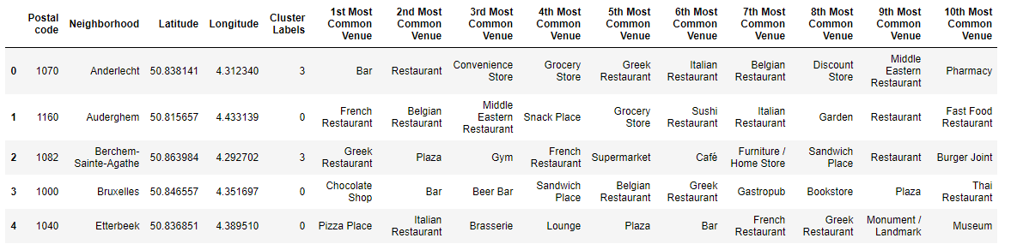
Cluster Neighbourhoods
Run K-means to cluster neighbourhoods into 7 clusters from Brussel_df data frame and then merge it with neighbourhoods_venues_sorted data frame into a new data frame named Brussel_merged.

Slide 14
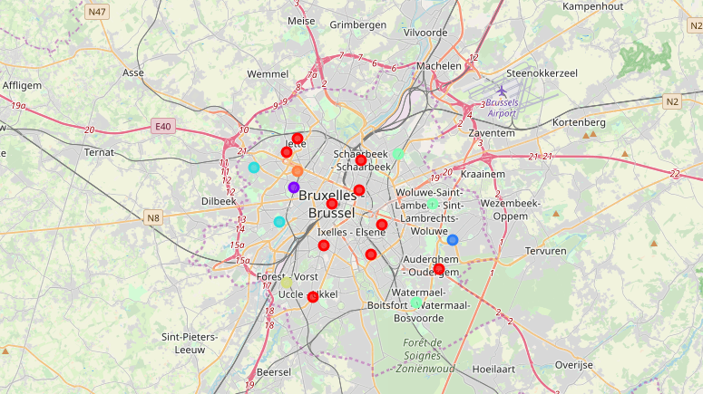
Visualizing resulting Clusters
From the resulting data frame – Brussel_merged, I then created a map showing all the clusters created.

Slide 15
Visualizing resulting Clusters
1st Cluster
Most of the municipalities situated in centre of Brussels consisting of lot of venues and some of the locations tourists would be interested in visiting.
Neighbourhoods which we would be most interested in are 1000 Brussels, 1040 Etterbeek and 1050 Ixelles.
These municipalities are located in the centre of the city and have most common venues like bars, restaurants and chocolate shops. Many of the touristic attractions like grand place, maneeken pis are located in centre of the city.

Slide 16
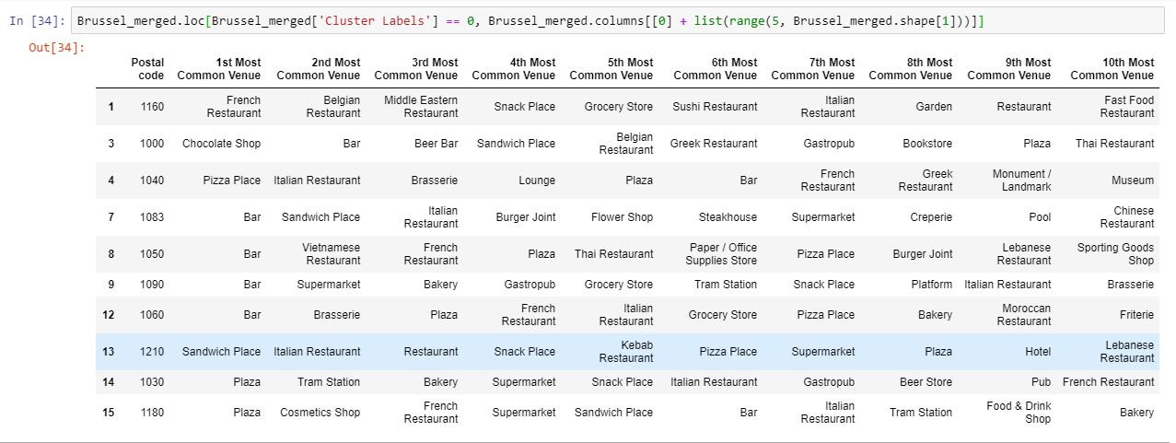
Continued…

Slide 17
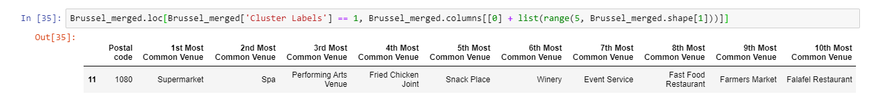
Visualizing resulting Clusters
2nd Cluster
The 2nd cluster consists of only one neighbourhood with most common venues like supermarket, spa and performing arts venue.

Slide 18
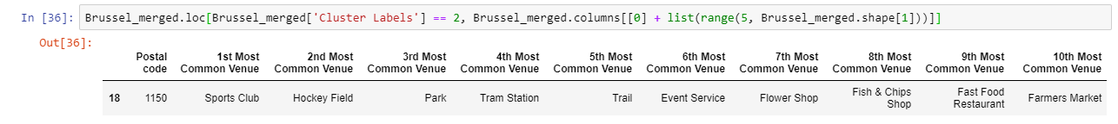
Visualizing resulting Clusters
3rd Cluster
The 3rd cluster as well has one neighbourhood with most common venues like Sports club, hockey field and park.

Slide 19
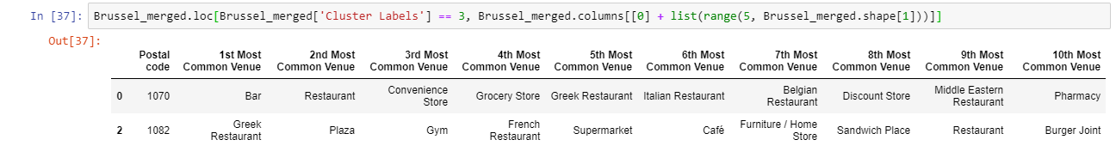
Visualizing resulting Clusters
4th Cluster
This cluster consists of 2 neighbourhoods with most common venues like Bar, plaza, convenience store and gym.

Slide 20
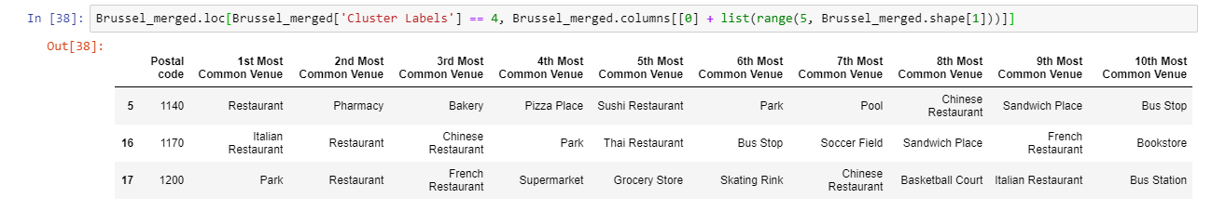
Visualizing resulting Clusters
5th Cluster
5th cluster consists of three neighbourhoods with most common venues like restaurant, park, bakery and pharmacy.

Slide 21
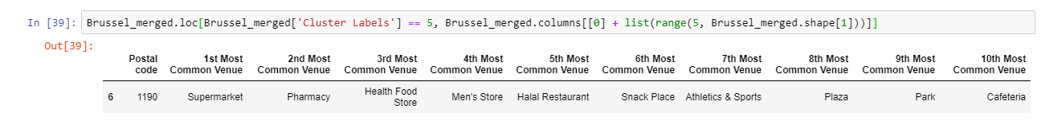
Visualizing resulting Clusters
6th Cluster
6th cluster consists of one neighbourhood with most common venues like supermarket, pharmacy and health food store.

Slide 22
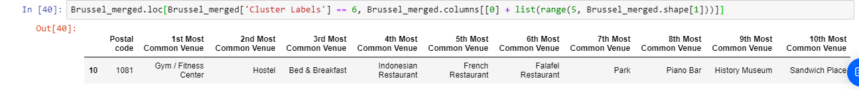
Visualizing resulting Clusters
7th Cluster
7th cluster consists of one neighbourhood with most common venues like gym, hostel and breakfast joint.

Slide 23
Results
The following are the highlights of the 7 clusters above:
The most common venues are clearly located in 1st Cluster (centre of Brussels), which makes the choice of the final location very easy.
As for restaurants, bars, coffee shops and chocolate shops are very popular also in 1st Cluster (centre of Brussels), Especially in 1000 Brussels, 1040 Etterbeek and 1050 Ixelles.
Although, the Clusters have variations, a very visible presence is the predominance of chocolate shops, tourists locations and bars and restaurants, so new hotel can be opened in those places.

Slide 24
Discussion and Conclusion
It is noticeable that 1st Cluster is the most viable clusters to build a new luxury hotel with guarantees. The proximity to a big number of Restaurants (lunch and dinner venues for guests), Coffee shops and other amenities and accessibility to station are also very important points to take into account when making the right choice.
The municipalities like 1000 Brussels, 1040 Etterbeek and 1050 Ixelles, lies in the centre of Brussels and have proximity to all kind of most common venues visited by locals as well as tourists. These neighbourhoods could be the best places to open new luxury hotel in the city.
In conclusion, this project would have had better results if there were more available data in terms of actual land pricing data within the area, public transportation access and allowance of more venues exploration with the Foursquare (limited venues for free calls). However, based on the available data, my advice to Marriott group would be to focus on 1000 Brussels, 1040 Etterbeek and 1050 Ixelles when investing on a new luxury hotel.

